Slide 1
Notes &
Password Manager
Made by: - Hem Chandra Upadhyay, Pramod Joshi, Mukul Kandpal.

Slide 2
Let’s Start
With our presentation here we go……….

Slide 3
Overview
01
This section we will give overview how this project work.
02
High-Level Approach
In this section we well learn about our approaches.
03
Primary goals
This section we well give you the goals we have
Index
04
Tasks
Step that we divide to complete projects

Slide 4
Overview
Objective
We will be creating an android application which helps to take notes at any time and helps to generate a very strong password for the security of our account and makes them available whenever we need. It's going to have two major functionalities at the same time.
Project Context
Password managing & note-taking are one of the most overlooked virtual activities in today's digital age. Various companies are constantly adding new features to note-taking and password management. Have you ever considered building your own note-taking and password managing application? So, instead of having and maintaining two different apps in your system, we'll be developing a single app which can perform both of these activities.
1

Slide 5
• The first task, once we get the development environment ready, will be to set up Android Studio & Firebase.
• Once we have everything in place, we can start off with creating the application, which will basically start with the login authentication.
• Next up is the home page building. In this project, we’ll be keeping it simple by showing two options like Notes & Password.
• In our project, we’ll need to manage three states: Note (to manage notes data), Password (to manage password data), and user (for managing the details of the currently logged-in user).
• For showing all the notes or passwords, we’ll be using List views or recycle views .
• Handling our database and authentication needs to be supported and we’ll be using Firebase for the same. Basically, the database will be used to store the login information for the users, but the resource can be used for storing notes and password information as well.
• Successful implementation of the above requirements will lead to the completion of the core implementation of our application. Next up, deploy!
High-Level Approach
2

Slide 6
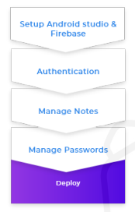
Project Stages
The project consists of the following stages:

Slide 7
Primary goals
• Create a login page for user login.
• Create a home page to display notes & password options.
• Create a note page to display all notes.
• Create a password page to display all passwords.
• Add functionalities like add note or password, delete note or password, and update note (if required).
3

Slide 8
Environment & Firebase setup
Task 1
Before the start of any development procedure, we need to set up the environment according to our application needs. Then connect your Android Studio with Firebase.
Requirements
• Install Android Studio on your machine.
• Install and set up JDK.
• Create a new Android project.
• Like any typical application, the source code of Java should be in a java folder and the source code of XML should be in a res folder.
• Connect with Firebase.
4

Slide 9

References
Task 1
• Download Android Studio.
• Download JDK.
• Create a new Android project.
• Creating a virtual Android device on your machine.
• A beginners guide to Graded.
• Run your Android application.
• Connect your Android App to Firebase.
Expected Outcome
The main objective of this milestone is to make sure that you have the required development environment in place. On completion of the above requirements, run the application using the virtual device and the end result should be as shown in the picture below.
5

Slide 10
Setting up Firebase and Authentication
Task 2
Firebase is a great service provided by Google for configuring the backend of any application with all the general necessities like database preparation, authentication using various methods, etc. In this milestone, we’ll be preparing our database and setting up authentication using email and password.
[Note: Use the references provided to implement the following requirements.]
6

Slide 11
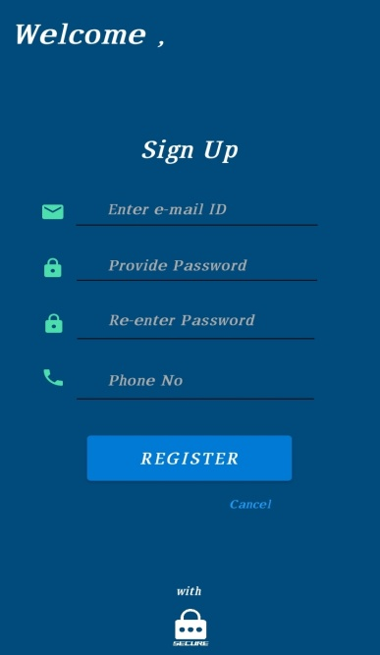
Requirements
Task 2
• Setup sign-in method using Email/Password.
• Declare the dependency for the Firebase Authentication Android library in your module ( app-level ) Gradle file ( usually app/build.gradle ).
• To use an authentication provider, you need to enable it in the Firebase console. Go to the Sign-in Method page in the Firebase Authentication section to enable Email/Password sign-in and any other identity providers you want for your app.
• Android has Material Components, which helps in building our frontend.
• Create a new activity named Login. Style the activity so that it looks similar to the one
shown below.
7

Slide 12
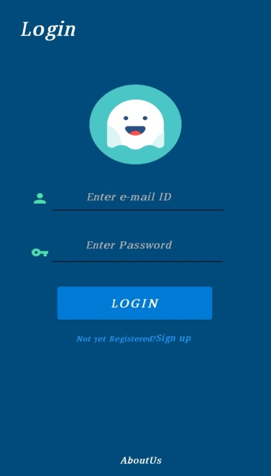
Task 2
References
• Material Components for Android
• Get Started with Firebase Authentication on Android
Expected Outcome
You should be able to develop the Login feature of your application and also integrate Firebase authentication for the same.
8

Slide 13
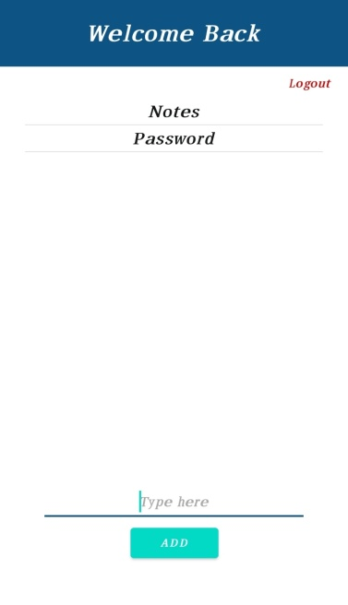
Creating home activity
Task 3
Now we will create an activity where there will be two options note and password.
• Style the activity so that it looks similar to the one shown below.
Creating note activity
Now we will create one more activity through which all the notes will be managed and besides add, delete and update functionality should work.
References
9
• Material Components for Android
• Read and Write Data into Firebase Database

Slide 14
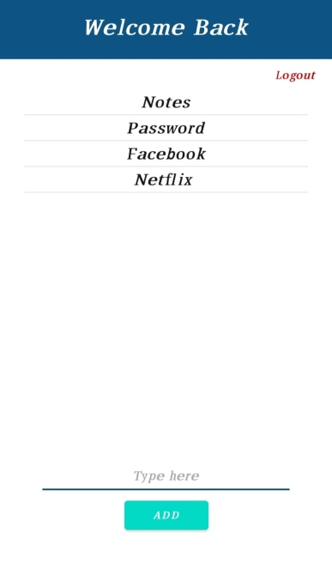
Task 3
Requirements
• We need a couple of icons like the navigation icon, note icon, and password icon.
• Create a new component called App-Bar in note activity.
• Add the necessary code in the xml and java files so that all the work is done accurately as mentioned earlier.
Expected Outcome
On completion of this milestone, the note manager of your application should look similar to the one shown below.
10

Slide 15
Task 4
Creating password activity
Now we will create one more activity through which all the passwords will be managed and
besides add and delete functionality should work feasibly.
Requirements
• We need a couple of icons like the password icon and the add icon.
• Create a new component called App-Bar in password activity.
• Add the necessary code in the xml and java files so that all the work is done accurately as mentioned earlier.
• Create a new function for generating password
• You should create a new function that will measure the strength of any password.
11

Slide 16
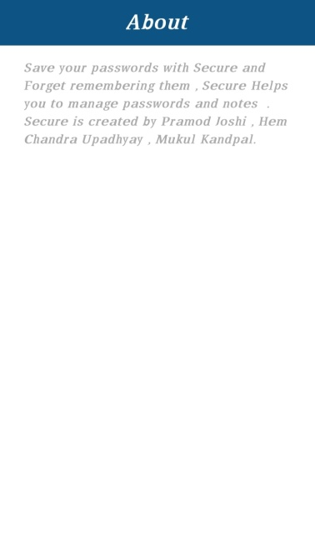
Task 4
References
• Material Components for Android
• Read and Write Data into Firebase Database
Expected Outcome
On completion of this milestone, the password manager of your application should look similar to the one shown below.
12

Slide 17
THANK YOU
Here our presentation ends!!!!!!!!!

